Slide 1
Project Title: Online Chatbot based Ticketing System
DEPARTMENT OF CSE-AIML (CSM) – IV-II Sem
Project Review
Batch 10
Team Members
1. K. Mohana Priya (21BQ1A4290)
2.K. Pavani (21BQ1A4281)
3. K. Anvesh Naik (21BQ1A4282)
4.K. Suvarna Raju (22BQ5A4207)
Project Guide:
Mr. Sd Beeban Basha,
Associate Professor,
Dept.of CSM,
VVIT

Slide 2
Online chatbot based Ticketing System
DEPARTMENT OF CSE-AIML (CSM) – IV-II Sem
Project Review
Batch 10:
Project Description:
The Online Chatbot-Based Ticketing System is an intelligent solution designed to simplify and enhance the process of booking tickets for museums. Combining conversational AI with a user-friendly interface, the system allows users to book tickets, manage bookings, and explore museum information through natural language interactions.
This system streamlines ticketing by integrating multilingual support, dynamic pricing, real-time availability checks, and secure payment gateways. It also offers personalized recommendations, accessibility features, and notifications to improve user experience. By leveraging advanced technologies like Natural Language Processing (NLP), Machine Learning, and cloud integration, the chatbot ensures seamless communication, scalability, and efficiency.
The chatbot addresses common challenges like long queues, inefficient manual processes, and lack of personalization, transforming the ticketing experience into a fast, hassle-free journey.
Project Functional Requirements: (Features)
User Registration and Authentication
Chatbot Implementation
Multi Lingual Support
Museum Search and Recommendation
Ticket Booking and Confirmation
Booking Management
Dynamic Pricing
Real Time Crowd Prediction
Notifications and Alerts
Feedback or Analytics Reporting
Accessibility Feature
Payment Integration

Slide 3
Online Chatbot based Ticketing System
DEPARTMENT OF CSE-AIML (CSM) – IV-II Sem
Project Review
Batch 10:
Member | Feature
Mohana Priya | User Registration and Authentication Chatbot Implementation Payment Integration
Pavani | Real Time Crowd Prediction Accessibility Feature Feedback or Analytics Reporting
Anvesh Naik | Multi Lingual Support Ticket Booking and Confirmation Booking Management
Suvarna Raju | Museum Search and Recommendation Dynamic Pricing Notifications and Alerts

Slide 4
Online chatbot based Ticketing System
DEPARTMENT OF CSE-AIML (CSM) – IV-II Sem
Project Review
Batch 10:
Project Tools Required:
Frontend: React.js, HTML, CSS, JavaScript
Backend: Node.js, Python (Flask)
Database: MySQL for transactional data, MongoDB for flexible museum metadata
Cloud Services: AWS
Machine Learning: TensorFlow, Scikit-learn for recommendation and crowd prediction
Security: JWT for authentication, AES for encryption
Payment Integration: Razorpay, PayPal, or Stripe

Slide 5
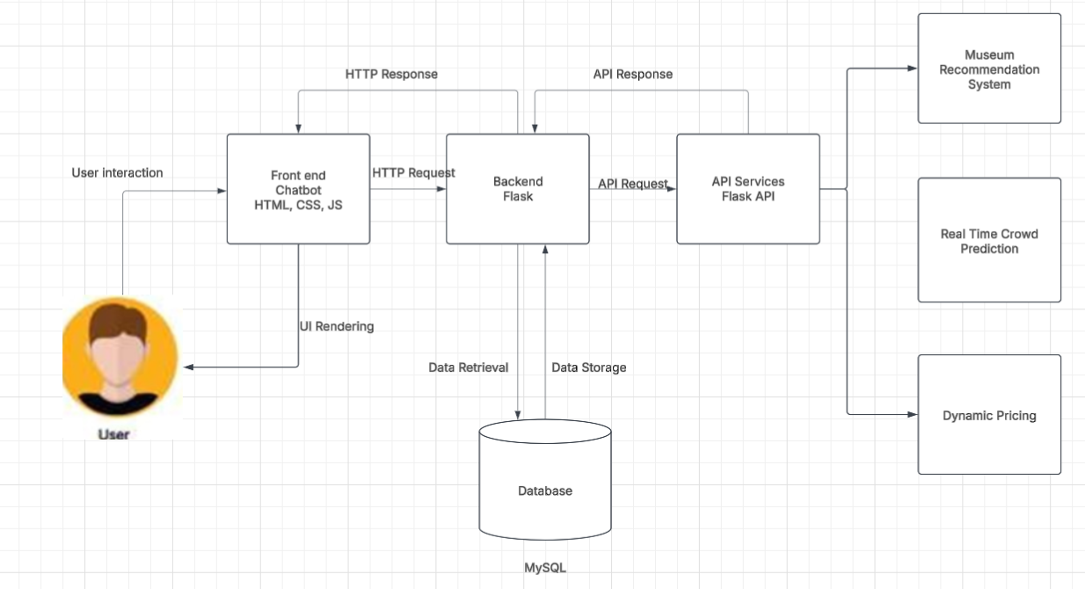
DEPARTMENT OF CSE-AIML (CSM) – IV-II Sem
Project Review
System Architecture

Slide 6
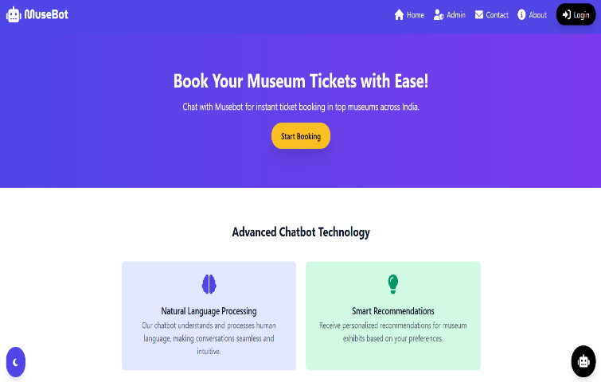
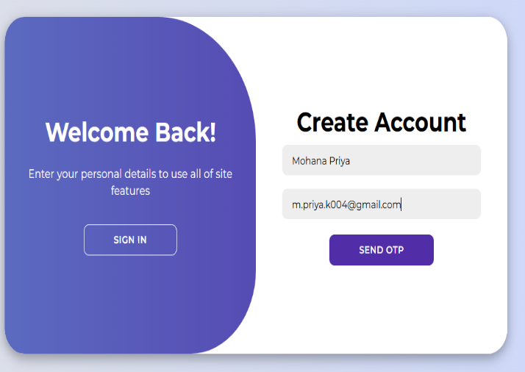
DEPARTMENT OF CSE-AIML (CSM) – IV-II Sem
Project Review
1.User Registration and Profile: The feature allows users to create accounts and personalize profiles with their booking history.

Slide 7
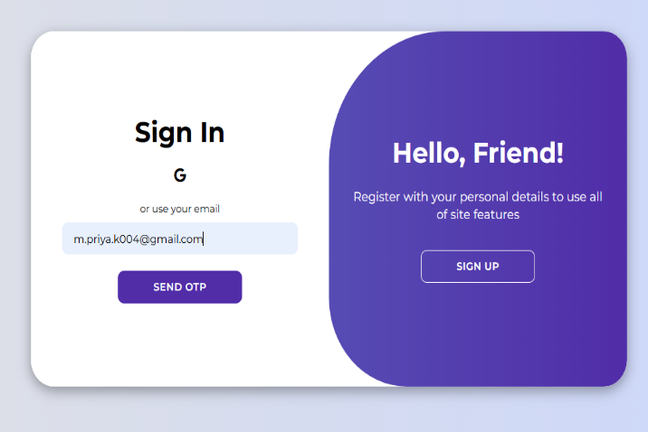
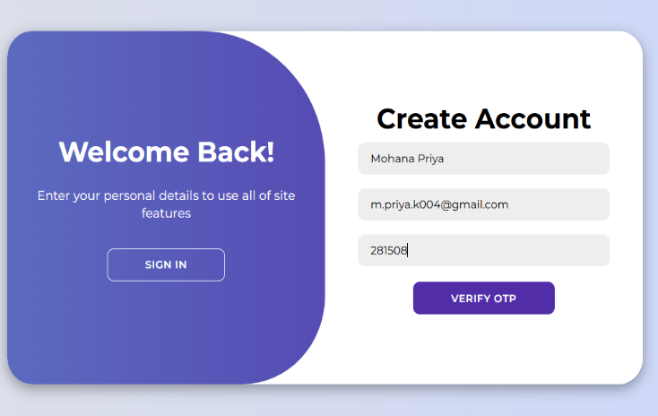
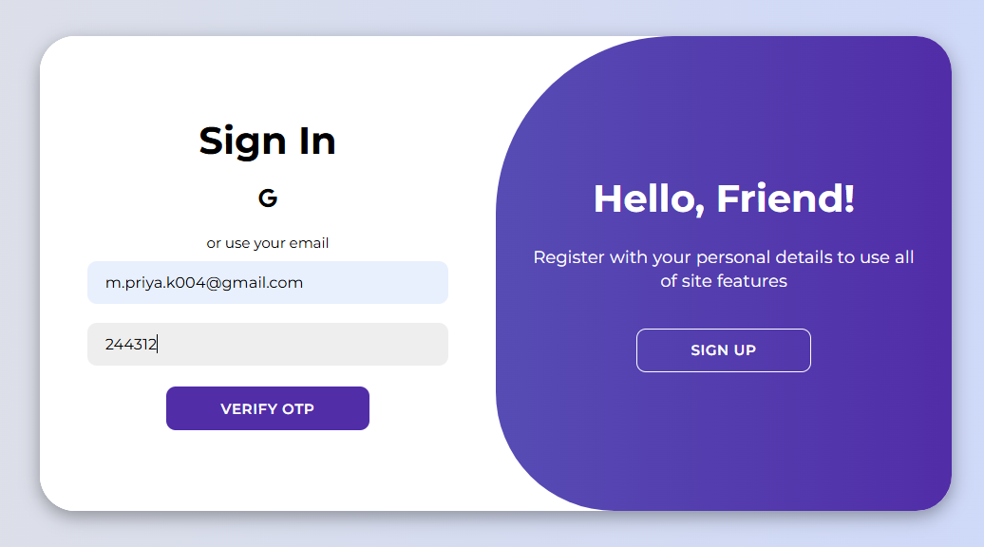
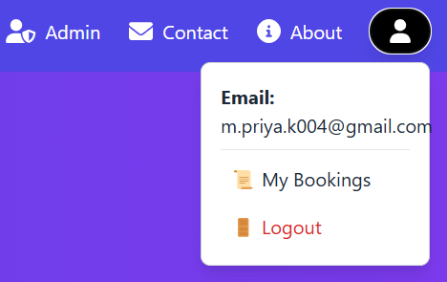
DEPARTMENT OF CSE-AIML (CSM) – IV-II Sem
Project Review

Slide 8
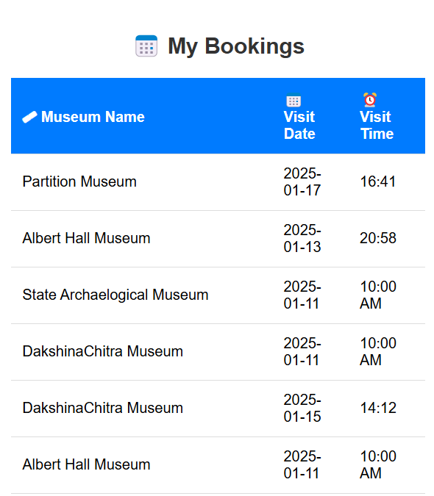
DEPARTMENT OF CSE-AIML (CSM) – IV-II Sem
Project Review

Slide 9
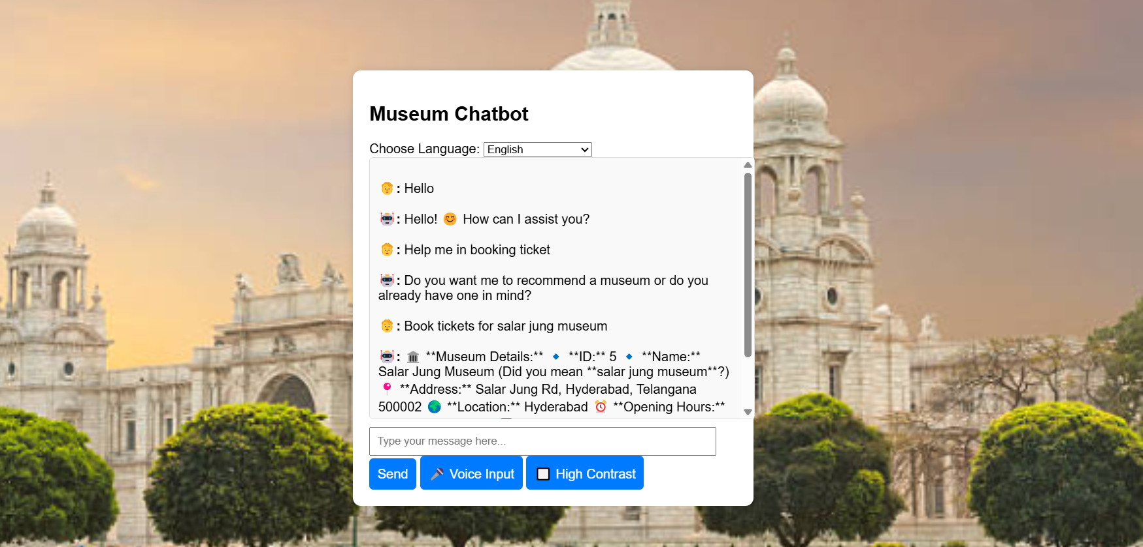
2.Chatbot Implementation: Using a structured rule-based framework and predefined intent classification, the chatbot was developed to facilitate seamless ticket booking. It efficiently processes user queries, identifies booking-related intents, and guides users through the reservation process, ensuring a smooth and intuitive experience.
DEPARTMENT OF CSE-AIML (CSM) – IV-II Sem
Project Review

Slide 10
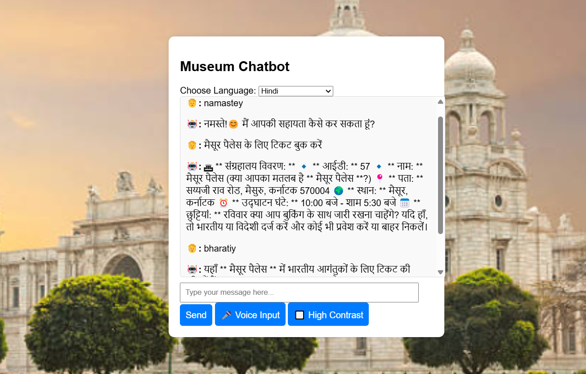
3.Multilingual Support: With this feature, users can effortlessly interact with the chatbot in their preferred language, ensuring seamless communication and accessibility. Supporting six major languages - English, Hindi, Spanish, Russian, Chinese, and Telugu—the system enhances user experience by breaking language barriers and enabling a more inclusive ticket booking process.
DEPARTMENT OF CSE-AIML (CSM) – IV-II Sem
Project Review

Slide 11
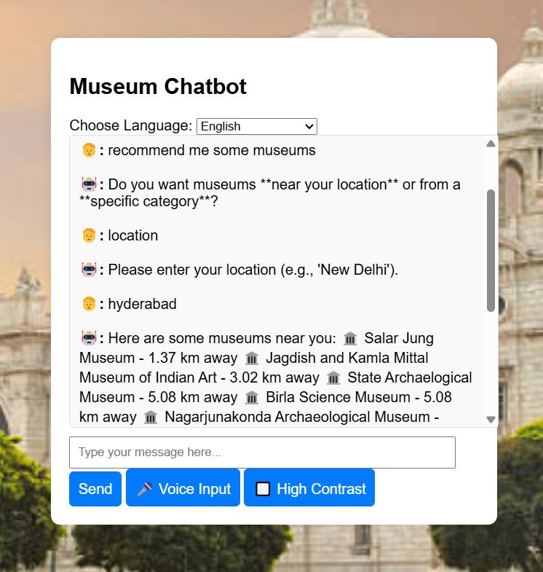
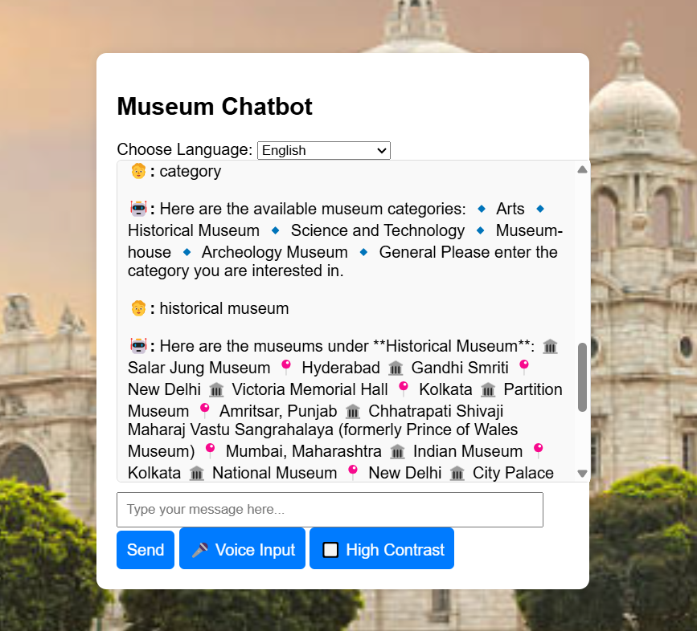
4.Museum Recommendation: With this feature, users receive personalized museum recommendations based on their preferred location and category, streamlining the ticket booking process.
DEPARTMENT OF CSE-AIML (CSM) – IV-II Sem
Project Review

Slide 12
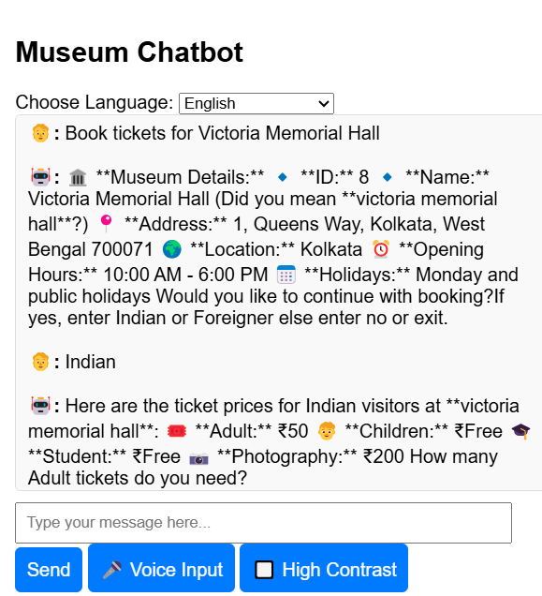
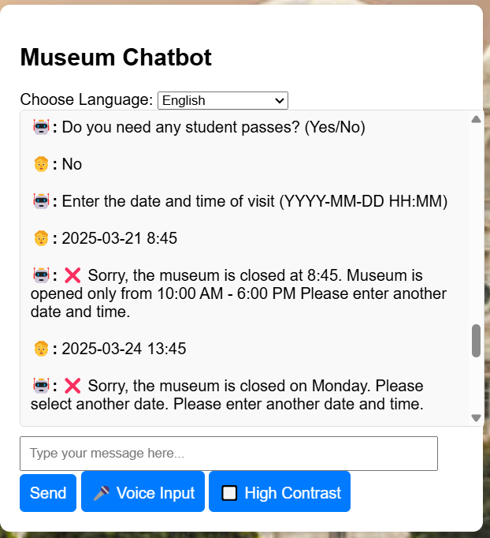
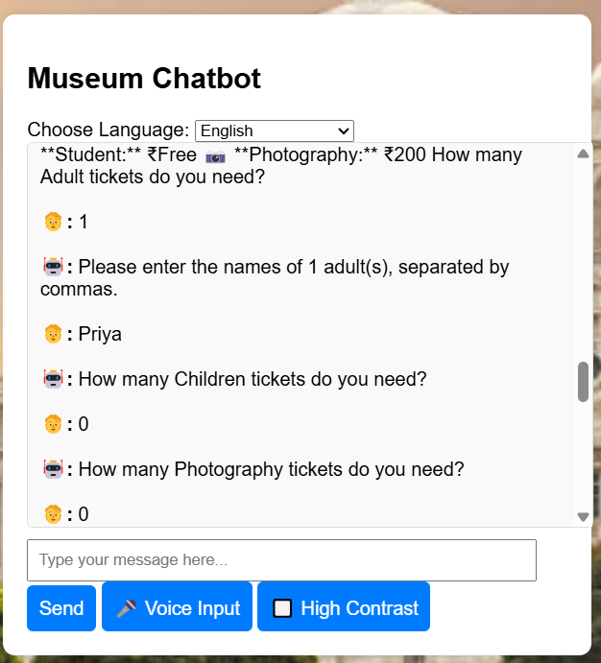
5.Ticket Booking and Notification: With this feature, users can seamlessly book tickets through the chatbot or web interface, selecting their preferred museum, date, and time. Additionally, the system provides real-time notifications and alerts, reminding users of upcoming visits, payment confirmations, and any important updates related to their bookings, ensuring a smooth and hassle-free experience.
DEPARTMENT OF CSE-AIML (CSM) – IV-II Sem
Project Review

Slide 13
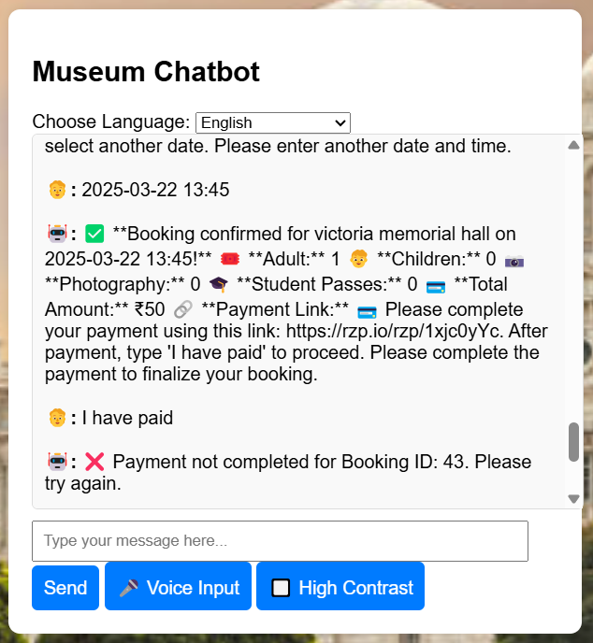
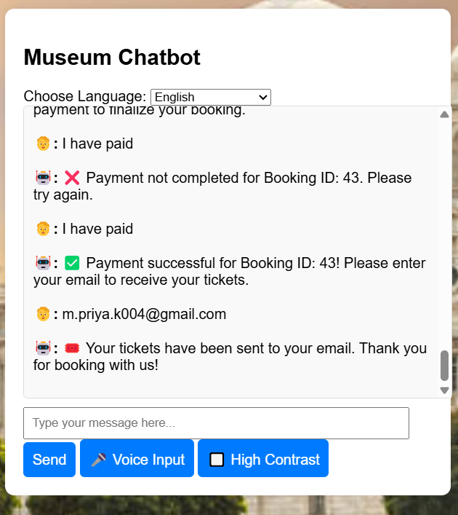
DEPARTMENT OF CSE-AIML (CSM) – IV-II Sem
Project Review

Slide 14
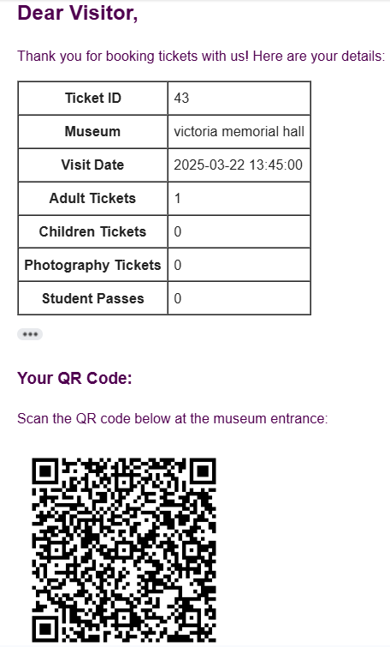
DEPARTMENT OF CSE-AIML (CSM) – IV-II Sem
Project Review

Slide 15
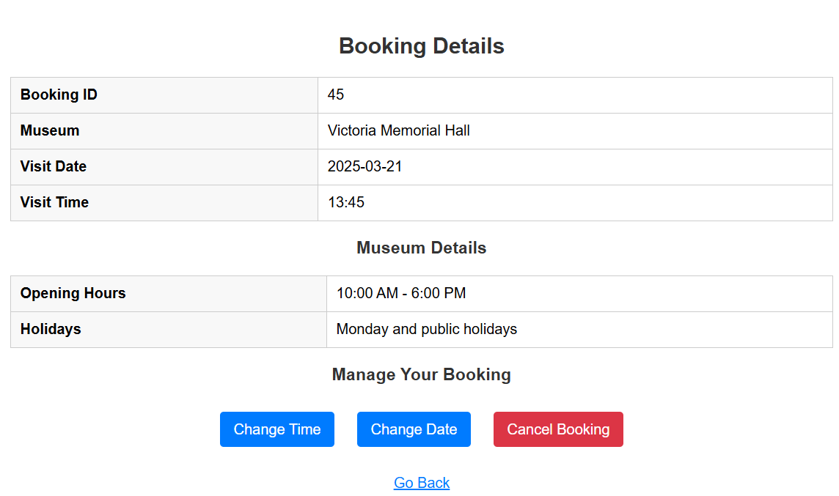
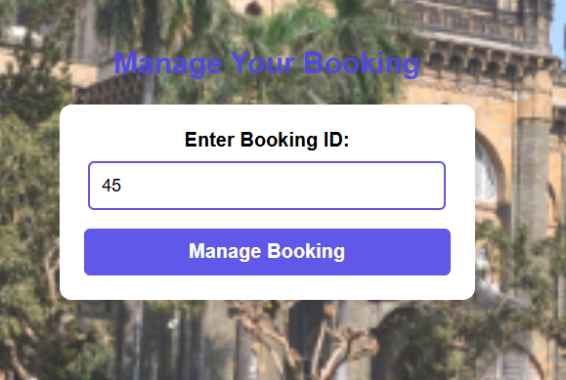
DEPARTMENT OF CSE-AIML (CSM) – IV-II Sem
Project Review
6.Booking Management: With this feature, users can manage their reservations effortlessly, including cancellation, rescheduling, and modifications to visit dates and times. The system ensures flexibility by allowing users to update their bookings as needed while providing instant confirmations and notifications, enhancing convenience and user control over their ticketing experience.

Slide 16
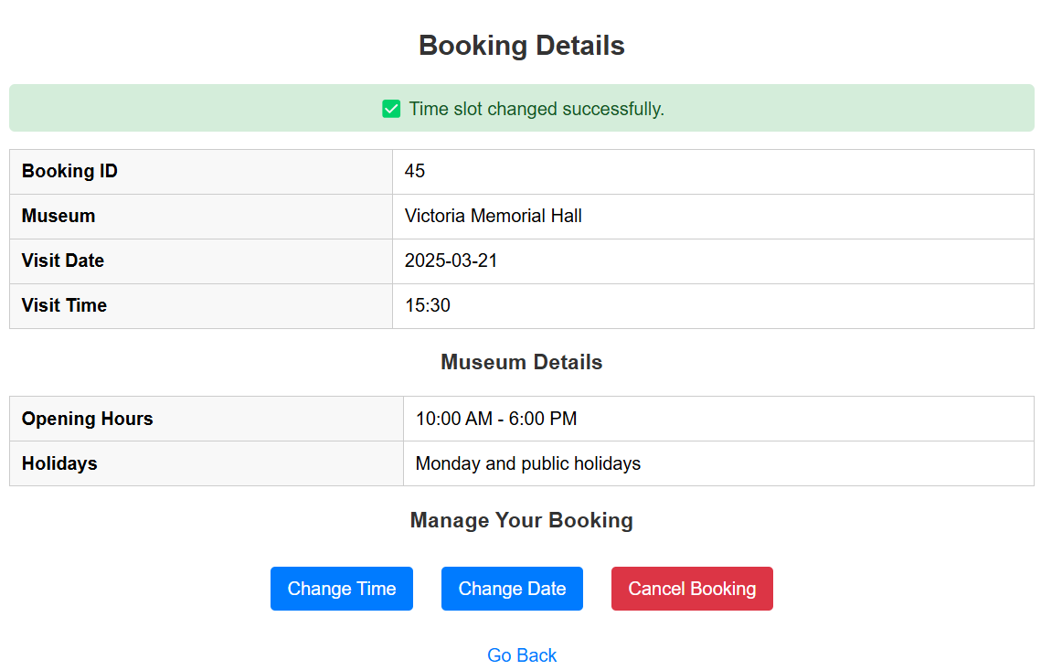
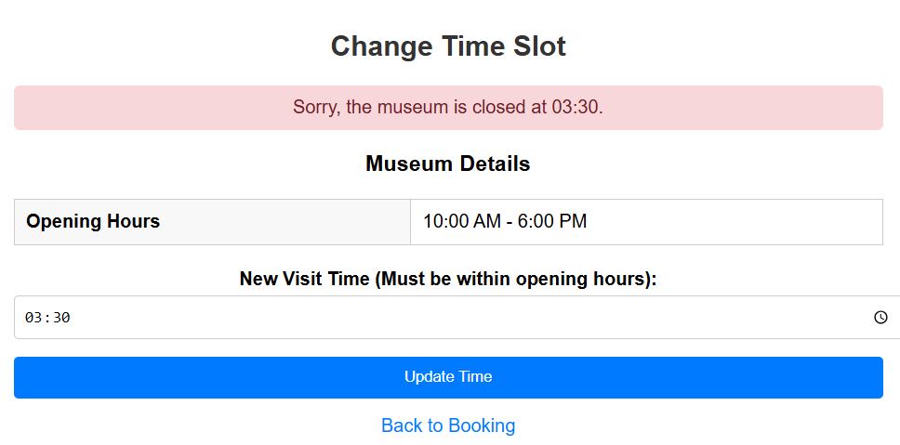
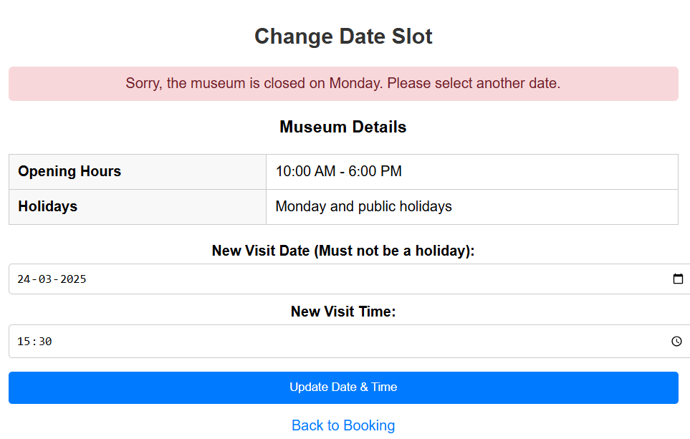
DEPARTMENT OF CSE-AIML (CSM) – IV-II Sem
Project Review

Slide 17
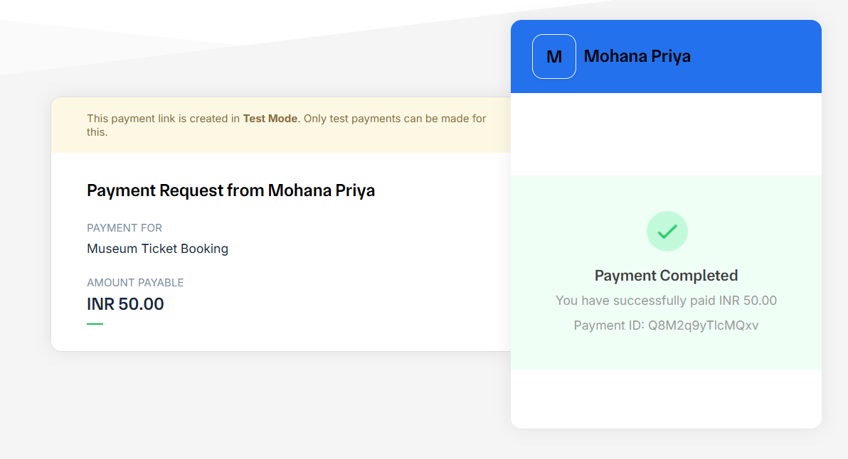
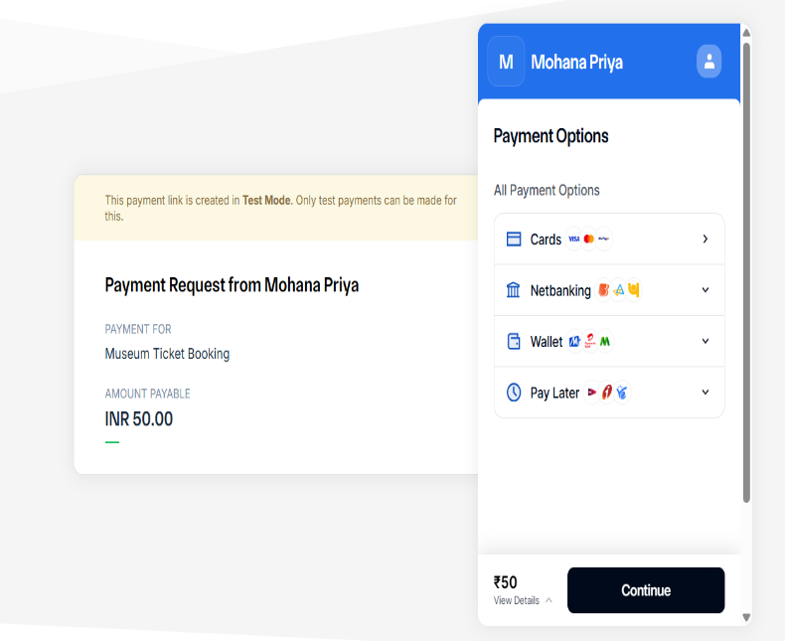
DEPARTMENT OF CSE-AIML (CSM) – IV-II Sem
Project Review
7.Payment Integration: With this feature, secure and seamless payment processing is enabled through Razorpay API, allowing users to complete transactions effortlessly. The integration supports multiple payment methods, including credit/debit cards, UPI, net banking, ensuring a smooth and reliable checkout experience for ticket bookings

Slide 18
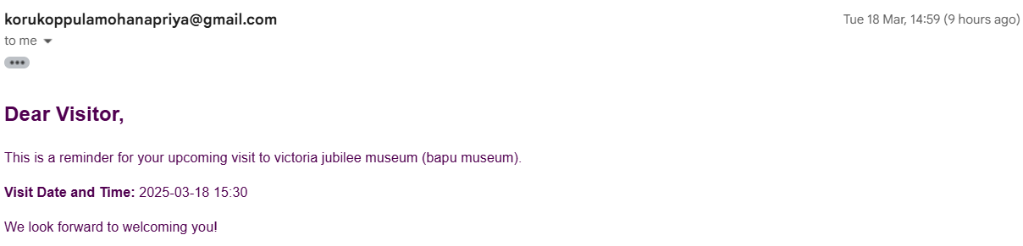
DEPARTMENT OF CSE-AIML (CSM) – IV-II Sem
Project Review
8.Notifications and Alerts: With this feature, users receive real-time notifications and alerts regarding their ticket bookings, payment confirmations, upcoming visits, and important museum updates. The system ensures timely reminders, reducing the chances of missed visits while enhancing user engagement and convenience

Slide 19
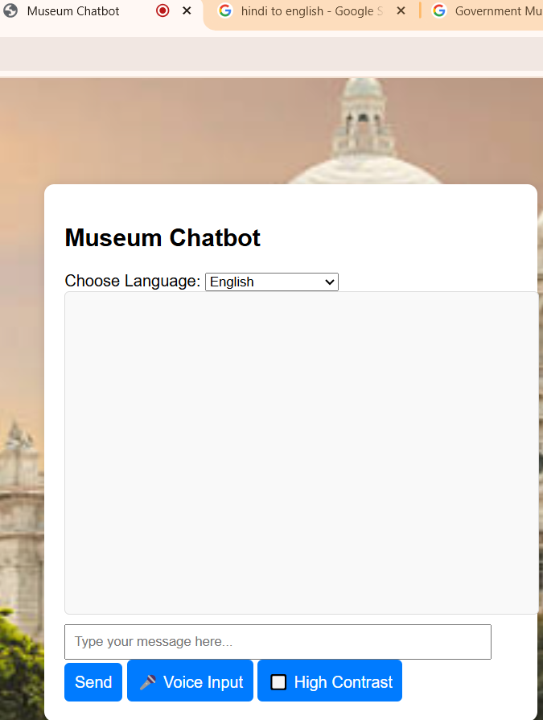
DEPARTMENT OF CSE-AIML (CSM) – IV-II Sem
Project Review
9.Accessibility Feature: With this feature, the system enhances usability for all users, including those with visual or motor impairments, by incorporating voice support and keyboard navigation. This ensures a more inclusive and user-friendly experience, allowing seamless interaction with the chatbot and ticketing system through speech commands and assistive technologies.

Slide 20
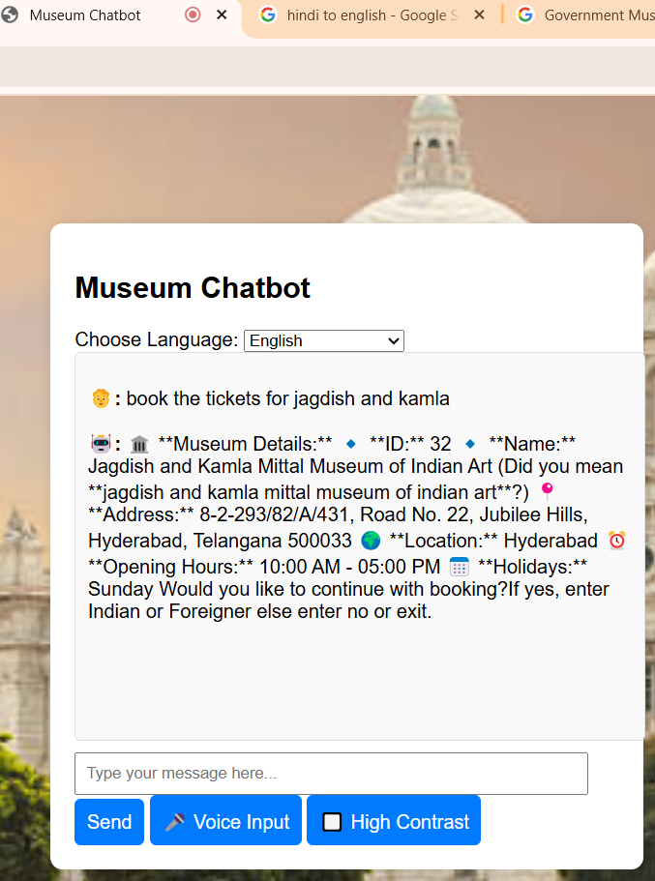
DEPARTMENT OF CSE-AIML (CSM) – IV-II Sem
Project Review

Slide 21
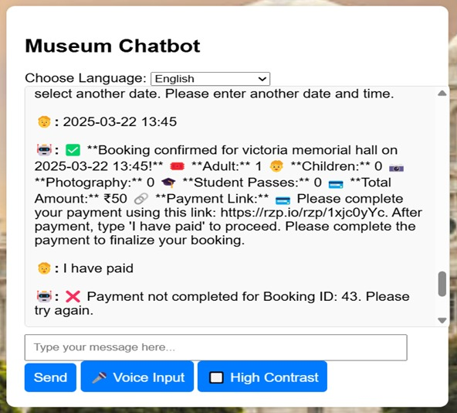
DEPARTMENT OF CSE-AIML (CSM) – IV-II Sem
Project Review
10.Dynamic Pricing: With this feature, the system implements Dynamic Pricing, allowing ticket prices to fluctuate based on admin-configured factors such as visitor demand, peak hours, special events, and seasonal trends. This ensures optimized revenue management, enables discount offerings, and enhances the overall flexibility of the pricing model to benefit both users and museum administrators.

Slide 22
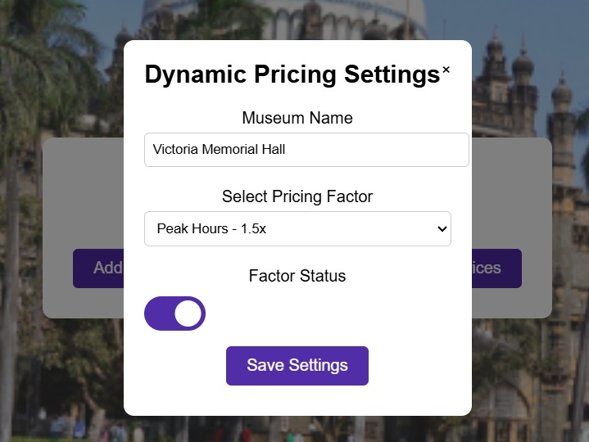
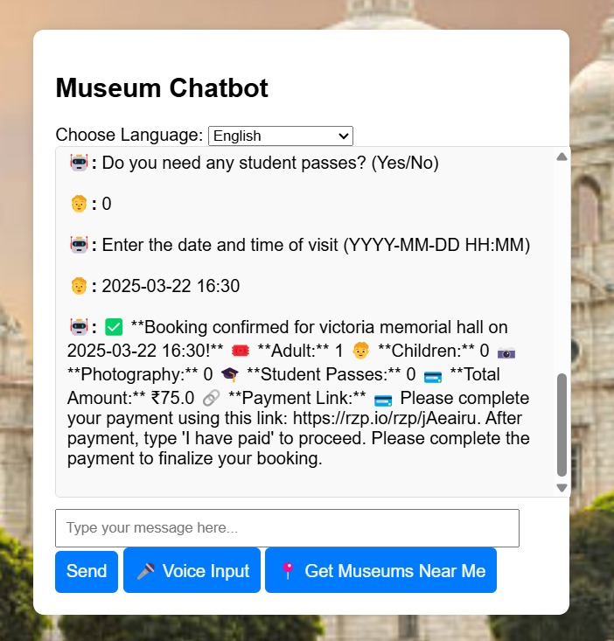
DEPARTMENT OF CSE-AIML (CSM) – IV-II Sem
Project Review

Slide 23
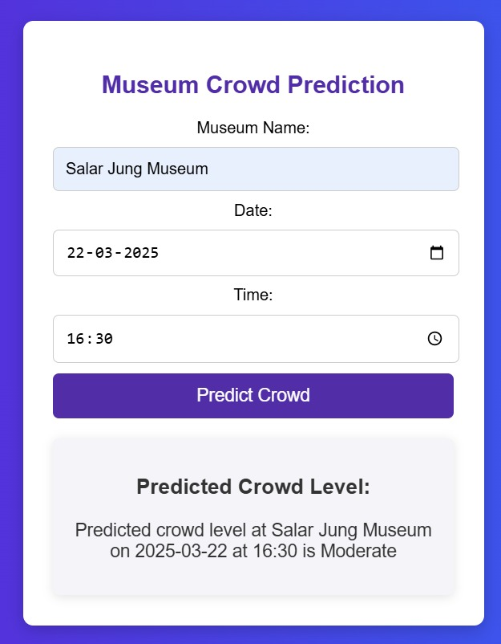
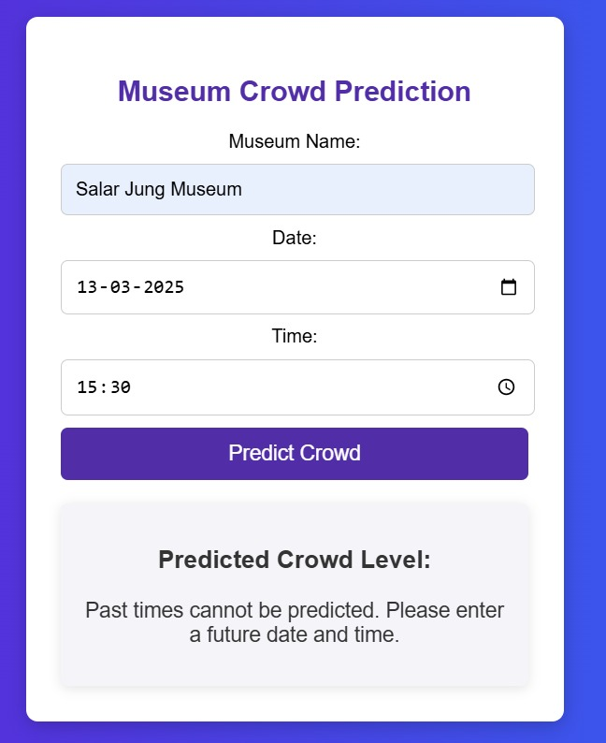
DEPARTMENT OF CSE-AIML (CSM) – IV-II Sem
Project Review
11.Real time Crowd Prediction: With this feature, the system utilizes Machine Learning algorithms, specifically RandomForestRegressor, to predict real-time crowd levels at museums. By analyzing historical visitor data, current bookings, and peak hours, users can make informed decisions about the best time to visit, ensuring a more comfortable and optimized museum experience.

Slide 24
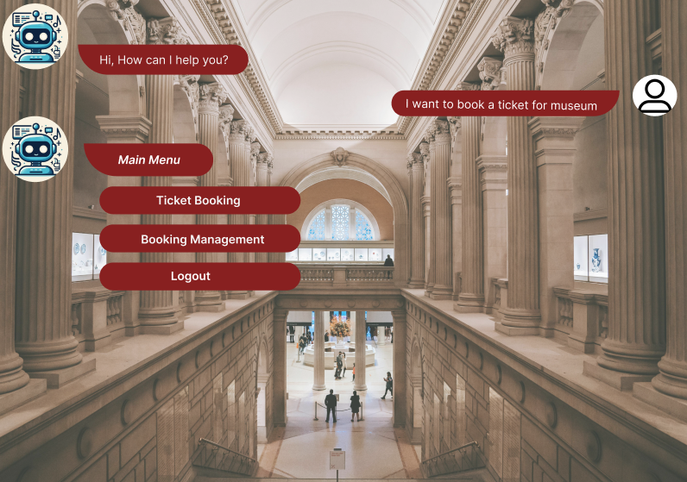
Online Chatbot based Ticketing System
DEPARTMENT OF CSE-AIML (CSM) – IV-II Sem
Project Review
Batch 10:

